Slide 1
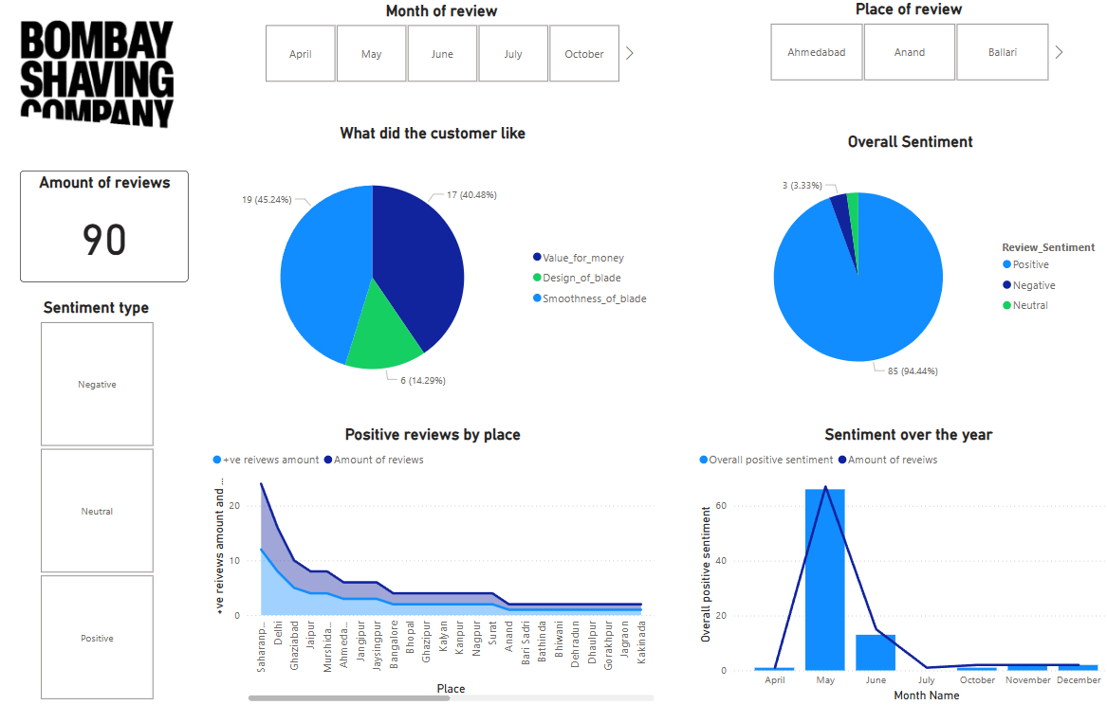
SENSI SMART 3
SENTIMENT ANALYSIS
-By Darren Pereira

Slide 2
About the product:
Launched In April 2024, Sensi Smart 3 is an affordable option for early shavers who fear a harsh shaving experience with regular razors or people with sensitive skin.
Sensi Smart 3 aims to give a pleasant and smooth shaving experience which is budget friendly at the same time.
What did the people think about it? Let’s find out

Slide 3
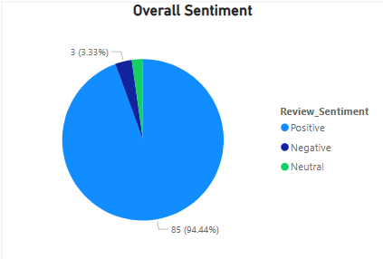
Key points of the data report
1.) Overall sentiment around the product
95% of the reviewer's gave a positive review and 2% gave a negative review and the rest of the lot were neutral.

Slide 4
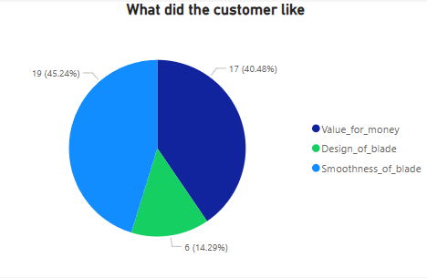
Key points of the data report
2.) What did the people like about the product?
About 46% reviewers said they liked the smoothness of the shaving experience and
another 40% mentioned that the product was value for money.
The reviews align to how the product was marketed.

Slide 5
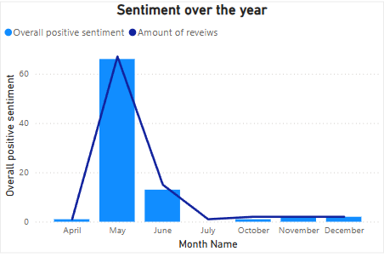
Key points of the data report
3.) Sentiment over the year
Most of the review's coming in the 1st three months of launch with May being the month with most positive reviews and June the second most.
A dip in the number of positive reviews was seen since June, could be due to the dip in the total number of reviews

Slide 6
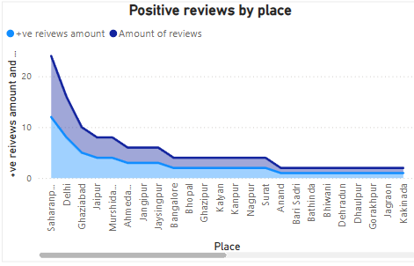
Key points of the data report
4.) Places with the most amount of positive reviews
Saharanpur, Ghaziabad and Delhi were the top 3 places with the most number of positive reviews.
Most of the positive review’s were from the northern part of India.

Slide 7
Suggestions
1.) Main focus should be on northern parts of India
Specially Saharanpur, Ghaziabad and Delhi as they contributed to most positive reviews and overall northern India seemed to resonate more with your product.
2.) Continue marketing the product in terms of sensitivity and budget friendly
People resonated with the fact that the product was budget friendly and smoothly glided on their sensitive skin.

Slide 8
How I got the data
To conduct the sentiment analysis, I planned to scrape the review, place of review and date of review of the product page on Flipkart using Selenium.

Slide 9
Analyzing the html structure
Review content was present in the <s> tag, but the longer reviews were only seen on clicking the “read more” button within the <span> tag.
Place of review content was present in the tag.
Date of review content was present in the tag.

Slide 10
Web scraping process and functions involved
We can carry out the scraping process by selecting the containers for the various elements in the page and set a for loop to loop through the containers.
Now to extract the required content from the containers we use an inbuilt selenium function find_elements

Slide 11
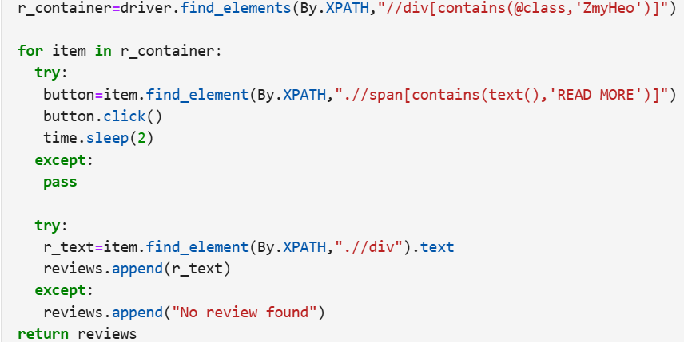
Web scraping process of reviews
For reviews the class name is ‘ZmyHeo’
Present in the div tag
For longer reviews we need to click the ‘read more’ button simply with the function click()
Finally, the review content is extracted using the .text function

Slide 12
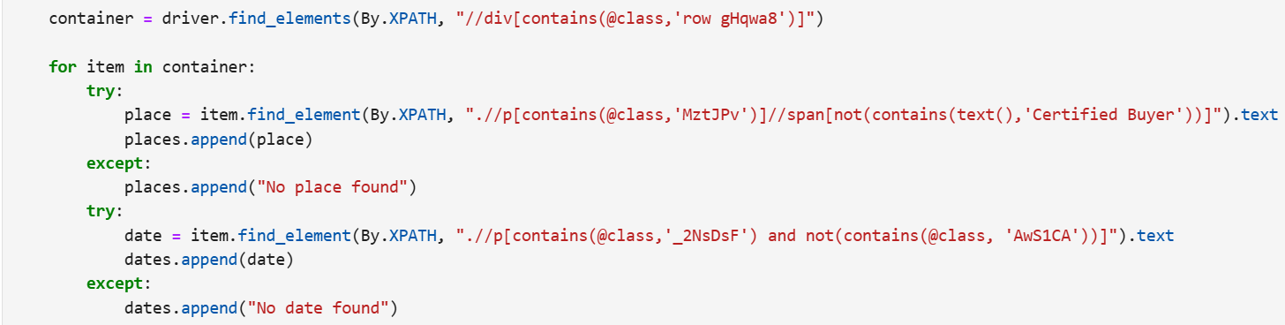
Web scraping process for data and place of review
Both the place and date of review were found in class name ‘row gHqwa8’

Slide 13
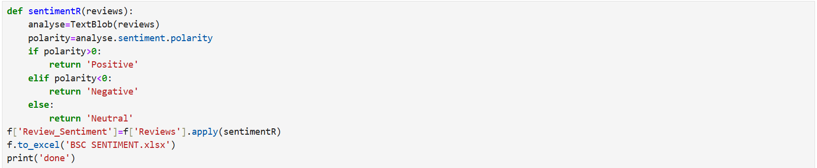
Sentiment Score Using Textblob
Used Text Blob library in python to give a sentiment score to every review scraped from the pages.
Here polarity is a number lying between [-1,1] where -1 is bad sentiment and 1 is positive sentiment.

Slide 14
Thank You
PPT and report by
Darren Pereira
My LinkedIn profile
https://www.linkedin.com/in/darenpereira/
My GitHub profile
https://github.com/DarrnP?tab=repositories

